Slide 1
Javascript Basic
Here is where your presentation bgins

Slide 2
Javascript Basic
1
Variables and Data types
2
Operators and Expressions
3
Control structures
4
Functions

Slide 3
Javascript Basic
5
Arrays and Objects
6
Javascript in the browser

Slide 4
1
Variables and Data types

Slide 5

Variables
Variables are containers for storing data (storing data values).
4 Ways to Declare a JavaScript Variable:

Slide 6
Comparison
var
let
const
Declares a variable that is scoped to the function or global scope, can be redeclared and reassigned
It is also hoisted to the top of its scope
Declares a block-scoped variable that can be reassigned
Declares a block-scoped variable that cannot be reassigned after initialization

Slide 7
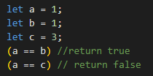


Data types
Number
String
Boolean
A string (or a text string) is a series of characters
Booleans can only have two values: true or false
All JavaScript numbers are stored as decimal numbers (floating point).

Slide 8
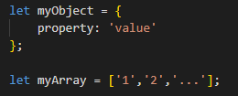

Data types
Null and undifined
Objects and Arrays

Slide 9
2
Operators and Expressions

Slide 10
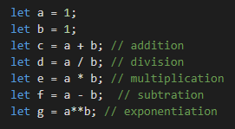
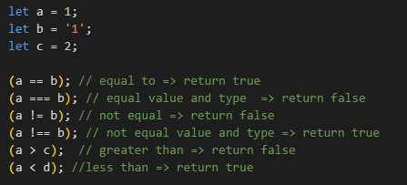
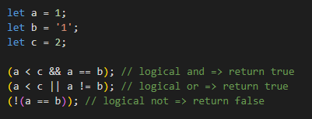
Operators
Arithmetic Operators
Comparison Operators
Logical Operators

Slide 11
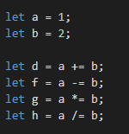

Operators
Assignment Operators
Comparison Operators
Syntax: condition ? <true expression> : <false expression>

Slide 12
3
Control structures

Slide 13
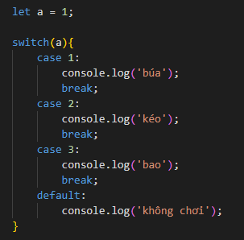
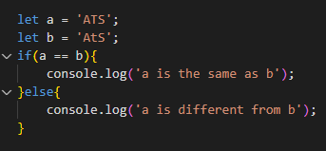
Conditional statements
If - else statements
Switch statements

Slide 14
Loops
for loops
while loops
Do While Loop
for (expression 1; expression 2; expression 3) {
// code block to be executed
}
while (condition) { // code block to be executed }
do { // code block to be executed } while (condition);
Notes:
Missing for/in and for/of => introduce later

Slide 15
4
Functions

Slide 16
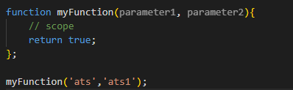
Defining Functions
A JavaScript function is defined with the function keyword, followed by a name, followed by parentheses ().
Notes:
Function parameters are listed inside the parentheses () in the function definition.
Function arguments are the values received by the function when it is invoked.
Inside the function, the arguments (the parameters) behave as local variables.
JavaScript has function scope: Each function creates a new scope.
Variables defined inside a function are not accessible (visible) from outside the function.
Variables declared with var, let and const are quite similar when declared inside a function.
When JavaScript reaches a return statement, the function will stop executing.

Slide 17
5
Arrays and Objects

Slide 18
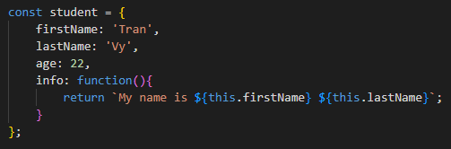
Object
Creating an object:
Notes:
It is a common practice to declare objects with the const keyword.. => Preventing accidental modification:

Slide 19
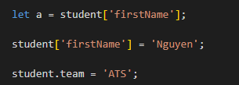
Object
Access and modify an object:

Slide 20
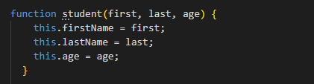
Object
Object constructors:

Slide 21
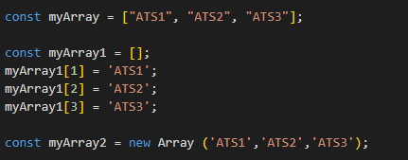
Array
Creating an Array:
Notes:
It is a common practice to declare arrays with the const keyword. => Preventing accidental modification:
You can also create an array, and then provide the elements:
Using the JavaScript Keyword new
There is no need to use new Array().
For simplicity, readability and execution speed, use the array literal method.

Slide 22

Array
Access and modify an array:
Notes:
It is a common practice to declare arrays with the const keyword. => Preventing accidental modification:
You can also create an array, and then provide the elements:
Using the JavaScript Keyword new
There is no need to use new Array().
For simplicity, readability and execution speed, use the array literal method.

Slide 23
For of and For in loop in array
Access and modify an array:
Notes:
It is a common practice to declare arrays with the const keyword. => Preventing accidental modification:
You can also create an array, and then provide the elements:
Using the JavaScript Keyword new
There is no need to use new Array().
For simplicity, readability and execution speed, use the array literal method.

Slide 24
Array
Array’s method:
pop(), push()
shift(). unshift()
forEach()
every()
some()
find()
filter()
map()
reduce()
Notes:
Array elements can be deleted using the JavaScript operator delete.
Using delete leaves undefined holes in the array.
Use pop() or shift() instead.
The concat() method does not change the existing arrays. It always returns a new array.

Slide 25
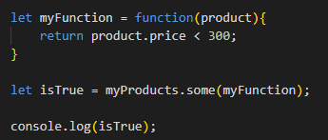
Callback
A callback is a function passed as an argument to another function.
Demo with example

Slide 26
6
Javascript in the browser

Slide 27
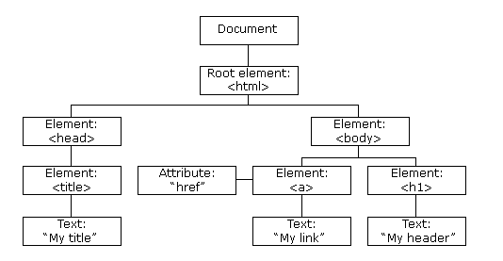
Document Object Model (DOM)
When a web page is loaded, the browser creates a Document Object Model of the page.
The HTML DOM model is constructed as a tree of Objects:

Slide 28
Document Object Model (DOM) (cont.)
The DOM is a W3C (World Wide Web Consortium) standard.
The W3C DOM standard is separated into 3 different parts:
Core DOM - standard model for all document types
XML DOM - standard model for XML documents
HTML DOM - standard model for HTML documents

Slide 29
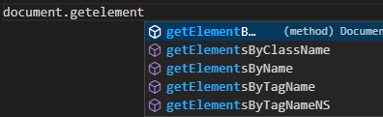
Accessing DOM Elements
The document object represents your web page.
If you want to access any element in an HTML page, you always start
with accessing the document object

Slide 30
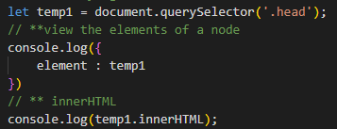
Modifying DOM Elements
After accessing DOM Elements, we can modifying them

Slide 31
Event
A JavaScript can be executed when an event occurs, like when a user
clicks on an HTML element.
Examples of HTML events:
When a user clicks the mouse
When a web page has loaded
When an image has been loaded
When the mouse moves over an element
When an input field is changed
When an HTML form is submitted
When a user strokes a key

Slide 32
Event handlers
Some common event handlers :
onClick: triggers when an element is clicked.
onLoad: triggers when a page is loaded.
onUnload: triggers when a page is unloaded.
onMouseOver: triggers when the mouse cursor moves over an element.

Slide 33
Event listeners
Add an event listener that fires when a user clicks a button:
element.addEventListener(event, function, useCapture);

Slide 34
THANK FOR WATCHING
Here is where your presentation bgins

